Slide 1
SMART DESK
An Intelligent System for Automated IT Support Ticket Analysis, NLP Classification, Team Routing, Resolution Time Prediction, and Anomaly Detection
By: Alhanouf Abdullah Alobaid · Sara Mohammed Alshahrani · Raghad Suliman Albalawi · Wojood Turki Almalki
Saudi Digital Academy · WCD Data Science Bootcamp · 2026

Slide 2
The Problem
Manual sorting is slow
BUSINESS QUESTION
1
Thousands of IT tickets must be classified and routed by hand.
How can organizations use NLP to classify issues, route tickets to the right team, predict resolution times, and detect anomalous ticket surges before they disrupt business?
Workflows are delayed
2
Employees wait while tickets sit in the wrong queue.
SLAs get breached
3
Late or misrouted tickets break service-level agreements.
2

Slide 3
Objectives & Scope
1
2
3
Clean and analyze historical ticket data
Classify issue type from the message using NLP
Route tickets to the responsible team
4
5
6
Compare BERT embeddings with TF-IDF
Predict ticket resolution time
Detect unusual days in volume, resolution time and reopen rate
Scope change: priority assignment was removed from the original proposal because the dataset has no priority labels. A Streamlit dashboard presents all results.
3

Slide 4
The Data: 100,000 IT Support Tickets
100,000
19
1,460
96
tickets (synthetic dataset)
columns per ticket
days: Jan 2022 to Dec 2025
unique message templates
Column type | Columns
Identifiers | ticket_id, customer_id
Time | created_at
Categorical | customer_segment, channel, product_area, issue_type, status, sla_plan, customer_sentiment, platform, region
Text | initial_message, agent_first_reply, resolution_summary
Numerical | resolution_time_hours, reopened, csat_score, has_attachment
PREDICTION TARGETS
issue_type
8 classes: issue classification
product_area
7 classes: team routing
resolution_time_hours
regression
4

Slide 5
Data Cleaning & Preparation
Check | Result / action
Duplicate IDs | 0 found
Negative resolution times | 0 found
Invalid CSAT or status | 0 found
CSAT = 0 (29.9%) | Means "not rated": set to missing
Missing region (19,997) | Filled with "Unknown"
Missing resolution summary (39,887) | Filled with "Pending"
Missing resolution time (39,887) | Kept: open, in-progress or on-hold tickets
6,108
resolution-time outliers (over 106.83 h) kept as genuine
Features added
Hour, day of week, message length, word count, ? and ! flags, tickets per customer; 51 columns after one-hot encoding.
5

Slide 6
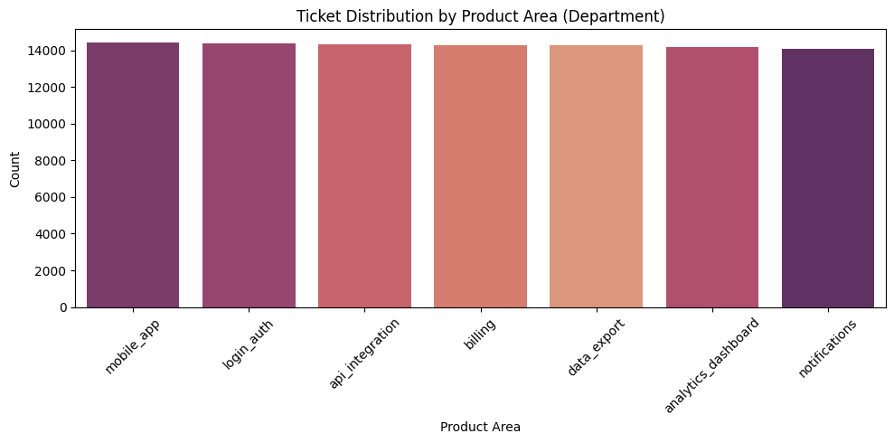
EDA: Tickets Are Evenly Distributed
Issue types balanced: 12,349 to 12,739 tickets each
Product areas balanced: 14,099 to 14,432 each
No peak hours or weekdays
Sentiment: 33% neutral, 26% negative, 9% very positive
About 5% of tickets reopened
No class balancing needed
6

Slide 7
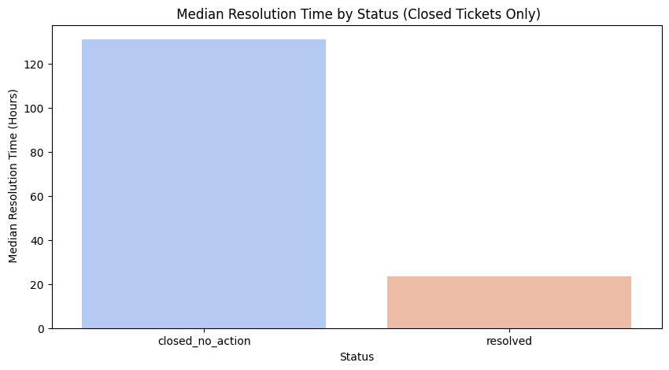
EDA: Resolution Time Has Little Signal
~30 h
131 h
median for every issue type, segment, region
closed without action vs 23.5 h resolved
KEY INSIGHT
Status is the only strong driver of resolution time, and it is only known after closure. Ticket attributes carry almost no signal.
7

Slide 8
Our Approach: From Raw Tickets to Insights
1
2
3
4
5
Clean & explore
Engineer features
Process text
Model & validate
Deliver
Quality checks, missing values, outliers and EDA
Time, message and customer features; one-hot encoding
NLTK cleaning, then TF-IDF unigrams and bigrams
Compare models per task with grouped splits
Streamlit dashboard with live classification and routing
Leakage prevention: routing uses only fields known when a ticket opens. Status, CSAT and reopen data were removed from the resolution-time model. Agent replies were excluded from classification.
8

Slide 9
Models We Tried
Issue type
TF-IDF + Random Forest (500 trees); TF-IDF + Logistic Regression as a grouped-split check
Team routing (7 teams)
Logistic Regression, LinearSVC, Random Forest: text only and text + metadata
Text representation
TF-IDF vs pre-trained Sentence-BERT (all-MiniLM-L6-v2), both with Logistic Regression
Resolution time
Gradient Boosting, HistGB, CatBoost, LightGBM, XGBoost, Random Forest, MLP, tuned LightGBM
Anomaly detection
Isolation Forest and Local Outlier Factor on daily volume, resolution time, reopen rate
9

Slide 10
Issue Classification: 100% Is Misleading
Why the gap?
All 100,000 messages come from only 96 templates, each tied to one issue type.
A random split lets the Random Forest memorize them (100% accuracy).
On unseen messages, 5-fold GroupKFold gives Macro F1 0.605 ± 0.107: the realistic estimate.
10

Slide 11
Team Routing: Model Comparison
57.4%
accuracy vs 14.4% baseline (4x better)
71.6%
correct team in top-3 suggestions
0.516
Macro F1 on unseen messages (± 0.112)
Metadata added nothing; generic messages fit several teams.
11

Slide 12
BERT vs TF-IDF: No Clear Winner
Hypothesis not supported
Pre-trained BERT matched TF-IDF, and scored slightly lower for routing.
Messages are short, templated and keyword-driven, so context adds little. BERT is expected to matter more on real, varied text.
Unseen scores here come from a single split and may vary by several points. The 5-fold results (0.605 and 0.516) are more reliable.
12

Slide 13
Resolution Time: Models Tie the Baseline
Why nothing beats the median
Mutual information of every feature is below 0.008.
Tuned LightGBM: MAE 15.166, still equal to baseline(15.170).
Early R² of 0.58 came from status, and 1.00 from a leaked target copy. Both were fixed.
13

Slide 14
Final Models & Why We Chose Them
Task | Selected model | Why
Issue type | TF-IDF + Random Forest | 100% on random split; realistic score is Macro F1 0.605 ± 0.107 on unseen text
Team routing | TF-IDF + Logistic Regression (text) | Best Macro F1 (0.580) and simplest; metadata added nothing; top-3 accuracy 71.6%
Text representation | TF-IDF | Equal or better than BERT at lower cost on short templated messages
Resolution time | Gradient Boosting (MAE loss) | Optimizes MAE directly; matches the 15.2 h baseline, which no model beat
Anomaly detection | Isolation Forest + LOF agreement | 45 high-confidence days; caught 10 of 10 injected surges
14

Slide 15
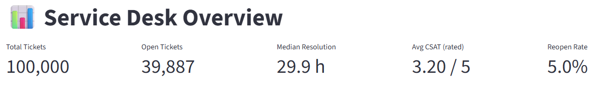
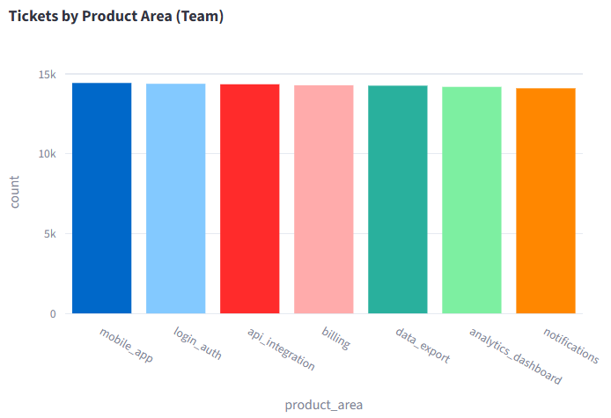
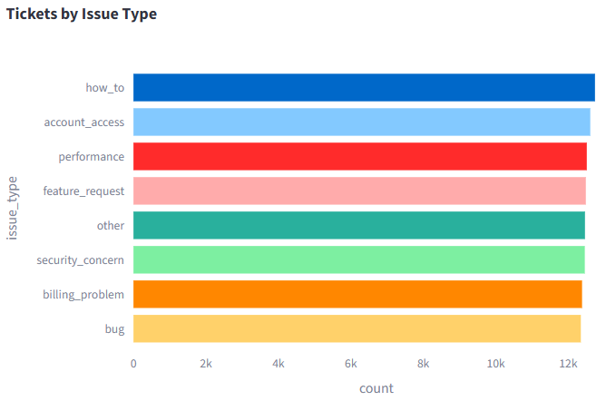
Dashboard Overview
A quick snapshot of 100,000 tickets (2022-2025).
Tickets are evenly spread across all 7 teams and 8 issue types, with no single area overloaded.
15

Slide 16
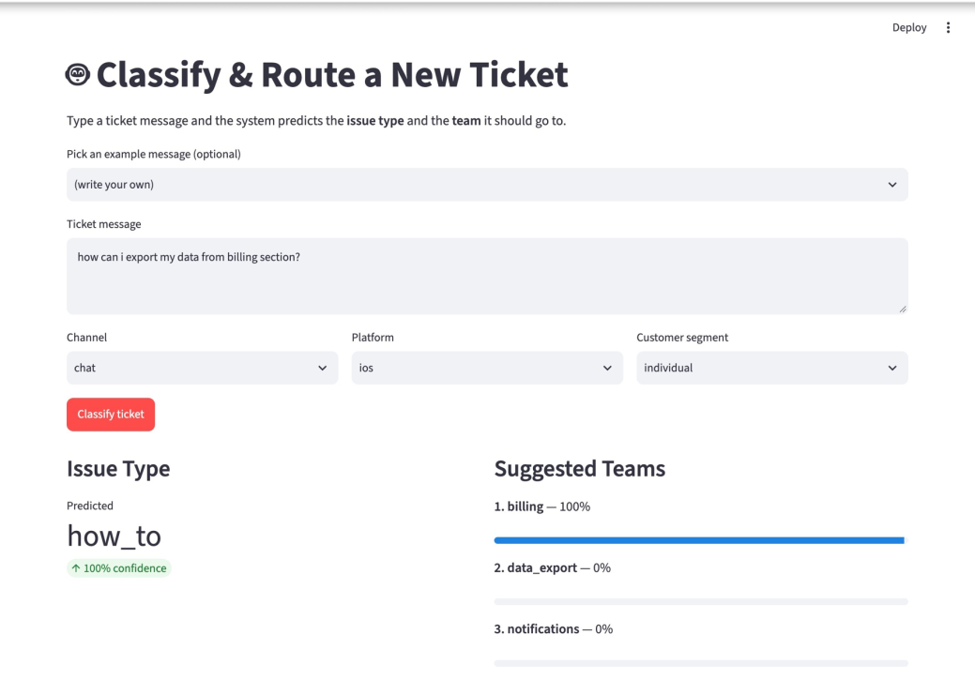
Interactive Dashboard for Managers
Overview: KPIs, tickets by team, issue type, hour and status
Classify & Route: type a message, get the issue type and top-3 teams
Anomaly Monitor: choose method, see flagged days and spiking issue types
Model Performance: comparisons and key findings
Built with Streamlit and Plotly; runs without retraining
16

Slide 17
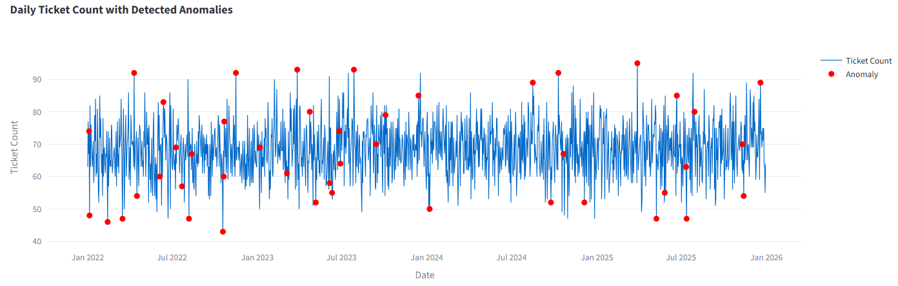
Anomaly Detection: Finding Unusual Days
73
45
10 / 10
12
anomalous days per model (5%)
flagged by both models
injected surges detected
strong spikes (z ≥ 3) to alert on
17

Slide 18
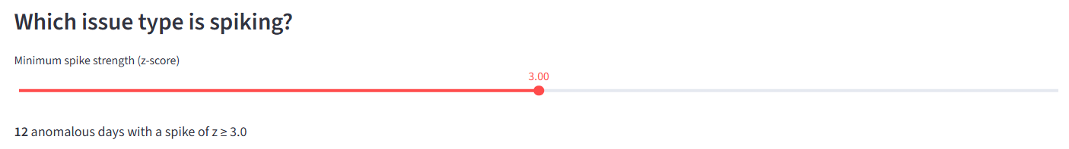
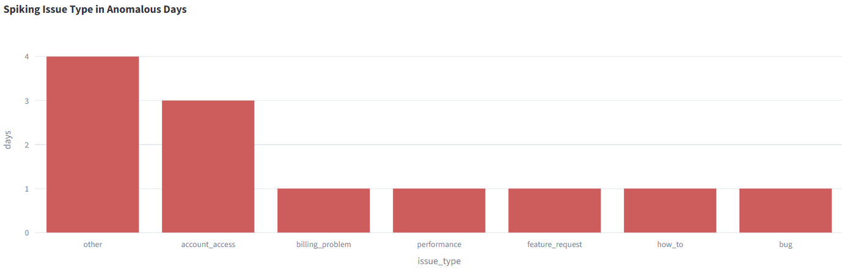
Slider sets minimum spike strength (z-score).
At z ≥ 3: 12 days worth alerting on.
"other" and account_access spike most often.
Tells managers not just when, but why.
18

Slide 19
Results & Insights
0.605
Honest classification score
71.6%
Routing that helps agents
Grouped splits exposed the template memorization behind 100% accuracy.
The right team appears in the top-3 list; generic messages cap accuracy.
15.2 h
Resolution time not predictable
45 days
Reliable anomaly alerts
Average prediction error (MAE), same as the median baseline.
Both models agree; only 12 strong spikes merit alerts.
19

Slide 20
Limitations & Next Steps
Limitations
Next steps
Synthetic data with mostly uniform distributions
Only 96 unique messages; unstable on unseen text
No priority labels, so priority was dropped
Generic messages cap routing accuracy
Anomaly counts depend on the fixed 5% threshold
Test the pipeline on real, varied ticket data
Fine-tune BERT once enough diverse text exists
Add workload and agent features for resolution time
Deploy the dashboard and connect live ticket data
20

Slide 21
Conclusion: Main Takeaways
1
An end-to-end pipeline
Cleaning, EDA, NLP classification, routing, resolution time, anomaly detection and a dashboard.
2
Validation was the key outcome
Grouped splits, leakage checks and injected surges kept every result honest.
3
Practical value and next step
Routing (top-3 for 71.6%) and anomaly alerts are useful now; real ticket data is the next step.

Slide 22
Thank you
Questions & Discussion ?

